Slide 1
Deepak Yadav
QuadPay Data Scientist Assignment

Slide 2
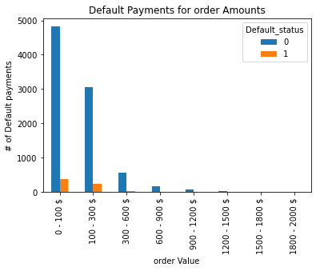
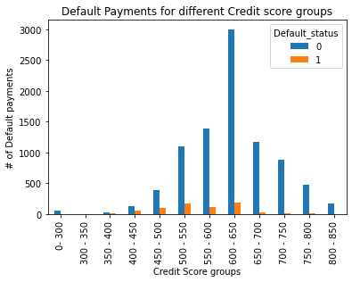
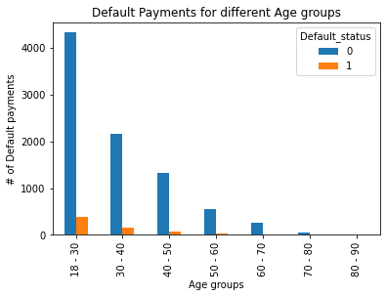
Payment Default event distribution different features
High number of Payment defaults for Low amount dollar values.
Customers with Credit Score between 400 – 700 has higher number of default Payments.
Customers between 18 – 40 age group has higher number of Default Payments.

Slide 3
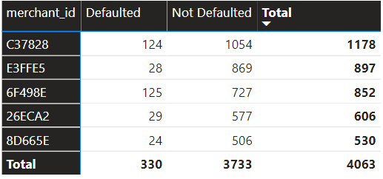
What surprised you about the results/trends observed in the data?
Almost 50% of the Payment default orders are from 5 merchants(i.e., 5 % of Total merchants)
customer_id | Count of order_id | Earliest checkout_started_at | Latest checkout_started_at | Days difference
04CB4C | 10 | 26-09-2018 16:21 | 05-10-2018 18:37 | 9.094571759
3566D6 | 5 | 30-08-2018 07:17 | 06-09-2018 01:58 | 6.778842593
1CB3A2 | 4 | 14-09-2018 16:32 | 24-09-2018 21:08 | 10.19134259
5ACD9E | 4 | 02-09-2018 06:14 | 08-09-2018 22:51 | 6.692743056
0D3ED9 | 3 | 30-08-2018 05:39 | 26-09-2018 02:21 | 26.86298611
26D2D8 | 3 | 04-09-2018 14:57 | 18-09-2018 18:58 | 14.16763889
333FF0 | 3 | 04-09-2018 00:52 | 21-09-2018 18:46 | 17.74579861
968795 | 3 | 07-09-2018 05:55 | 24-09-2018 22:45 | 17.70111111
C91CF8 | 3 | 10-09-2018 17:50 | 21-09-2018 03:28 | 10.40168981
CAE413 | 3 | 04-09-2018 18:44 | 09-09-2018 23:09 | 5.183715278
Customers those have done multiple defaults payments has an average transaction time window of 7 days.
Example customer : 04CB4C has 10 default orders within 9 days. i.e., before 14 days time for 2nd installment.

Slide 4
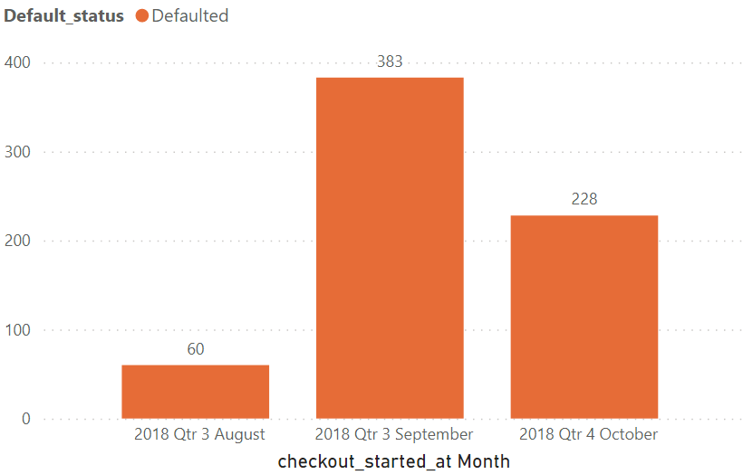
Payment default Trend
Most of the Payment Default events occurred in the Month of September.
Lowest Payment default events in August month.

Slide 5
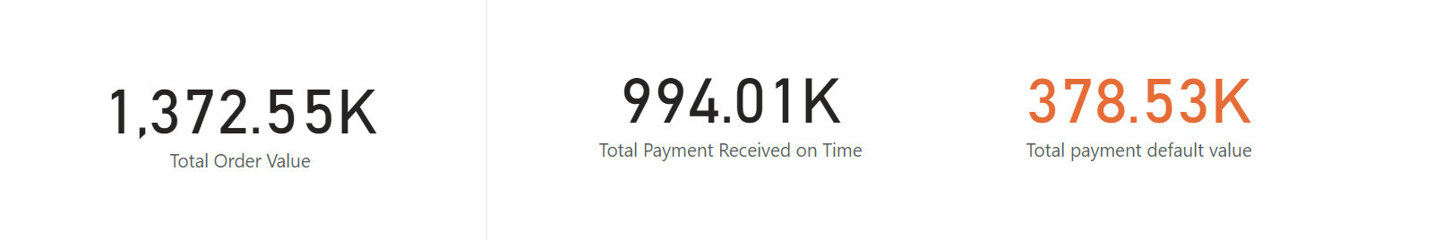
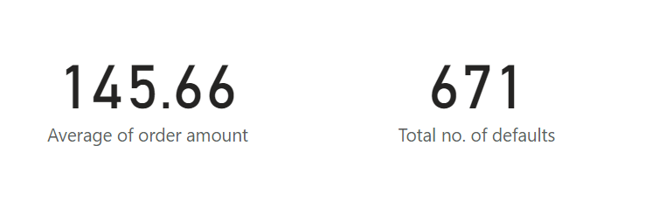
Total 378.53K Loss of on time payment which is 25.57% of total order value.
Aim is to predict payment default events and to keep approval rates high.
A Classification model can identify the probability of a default event upon transaction in real-time, provided few important data points like Customers Age, Credit score and Transaction amount.

Slide 6
Classification Model approach
Logic behind Target Variable
Since our aim is to identify transactions which can be defaulted in future Payments.
If a Customer has made all payments (all 1's) , Default status will be 0
If a Customer has missed even a single payment, Default status will be 1.
Variables used
Customer's age, Customers Credit score, order amount, Customers Previous Default.
Variables not used ( can be discarded)
order_id, customer_id, merchant_id (Not relevant features for Modeling)
checkout_started_at, credit_decision_started_at (Not relevant features for Modeling)
approved_for_installments (all Values are True, Not relevant features for Modeling)
customer_billing_zip, customer_shipping_zip (Not relevant features for Modeling)

Slide 7
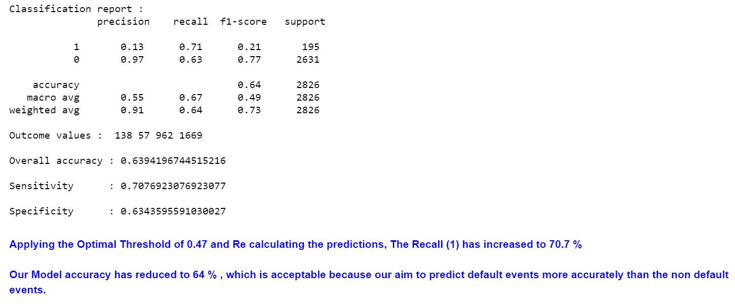
Logistic regression Approach

Slide 8
Estimated Loss after Predicting the default events (with recall value of 0.7076)
Average Order amount X Total Defaults X (1 – Recall value)
145.66 * 671 * (1 – 0.7076) = 28.578 K
Total payment default loss value reduced to 28.57K from 378.53k.

Slide 9
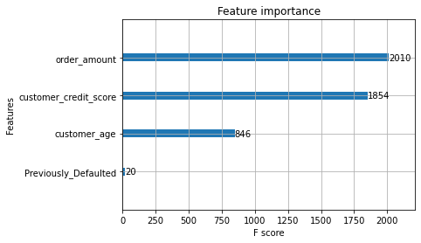
Feature Importance from XGB

Slide 10
What additional data would you like to see that might help build a better installment-approval classifier?
Few of the variables if available could have improved the predictions.
Monthly salary of the Customer.
Additional Loans.
Customer gender
Employment Type

